Slide 1
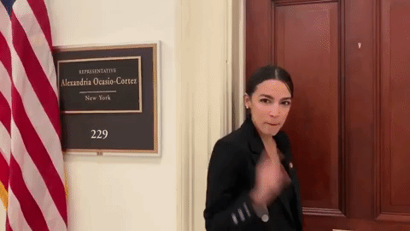
The AOC Challenge
KROLL BOND RATING AGENCY, INC

Slide 2
Agenda
Pete
Introduction
CMBS
Predictive Modelling
Text Mining
Traditional Regression
Words
Natural Language Processing
CNN
GPU
Jupyter Notebook
Paperspace Gradient
Colab

Slide 3
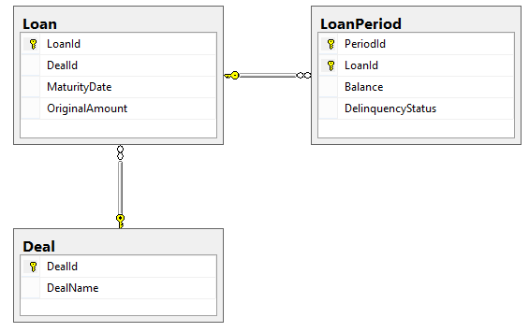
SQL Challenge
Notes:
My first day a KBRA, even before I was hired, I was show these three objects.

Slide 4
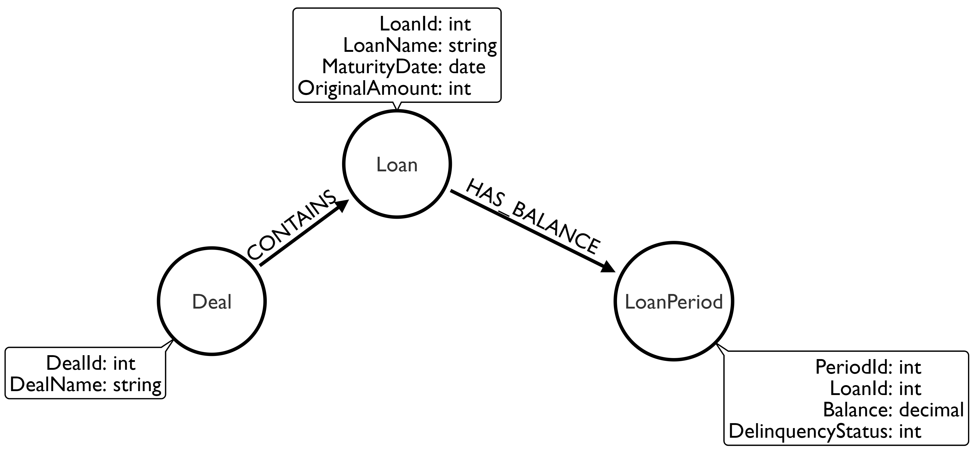
Graph Challenge
Notes:
A different way of looking at our main three objects.

Slide 5
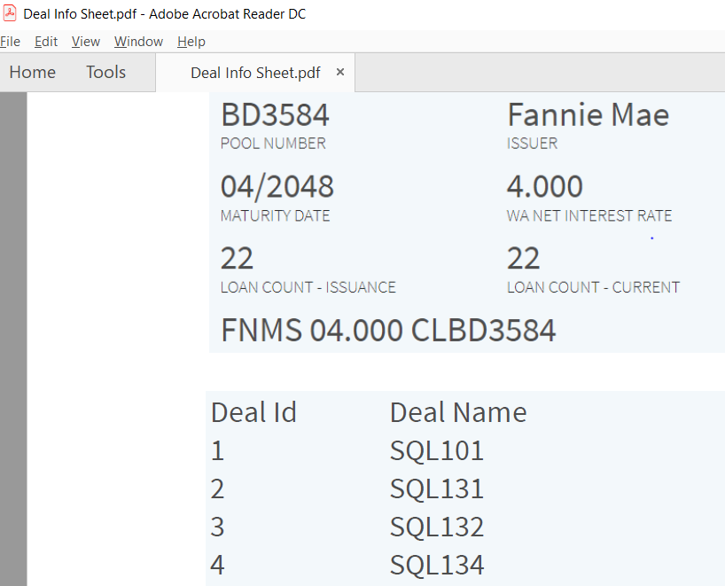
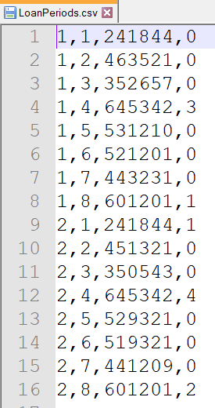
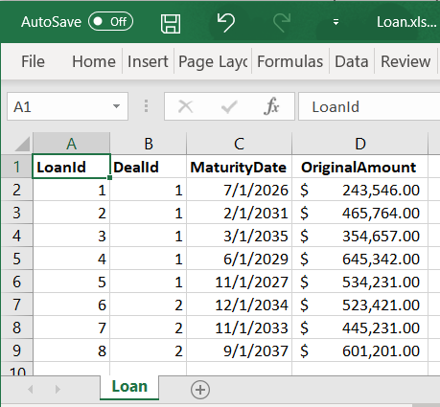
Analyst Challenge
Notes:
Here are the three objects Deals, Loans and Periods.

Slide 6
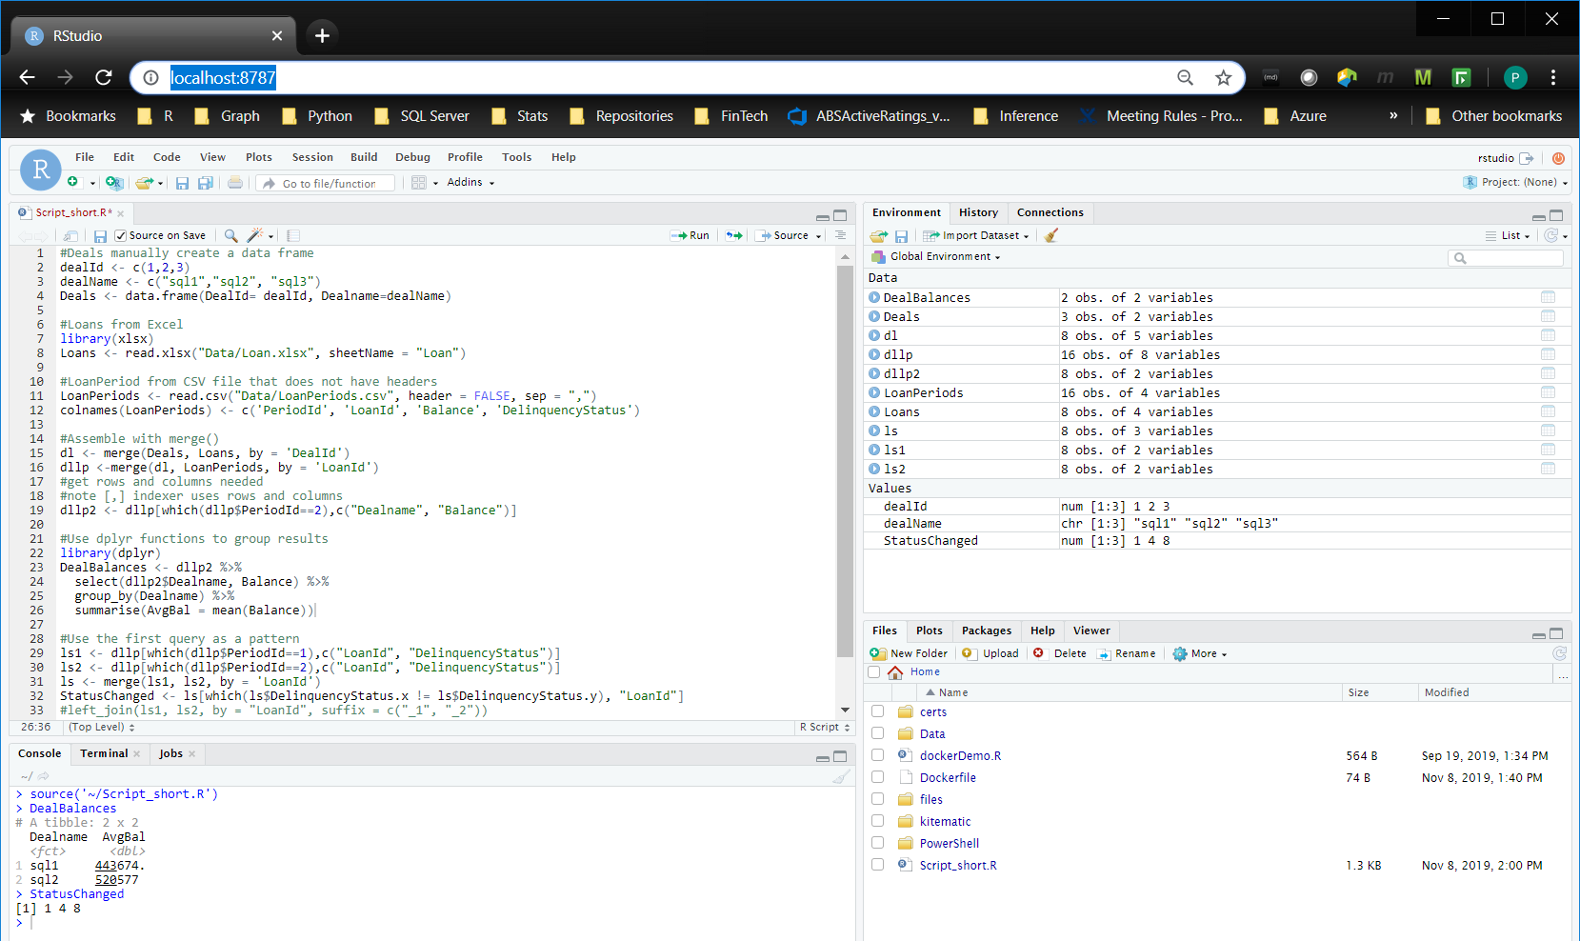
Analysts can meet their challenge in RStudio
Note: This instance of RStudio is running in a Docker container
Notes:
Matt McDonald presented his overview of Quantitative Modeling where he showed that we need to move away from Excel.

Slide 7
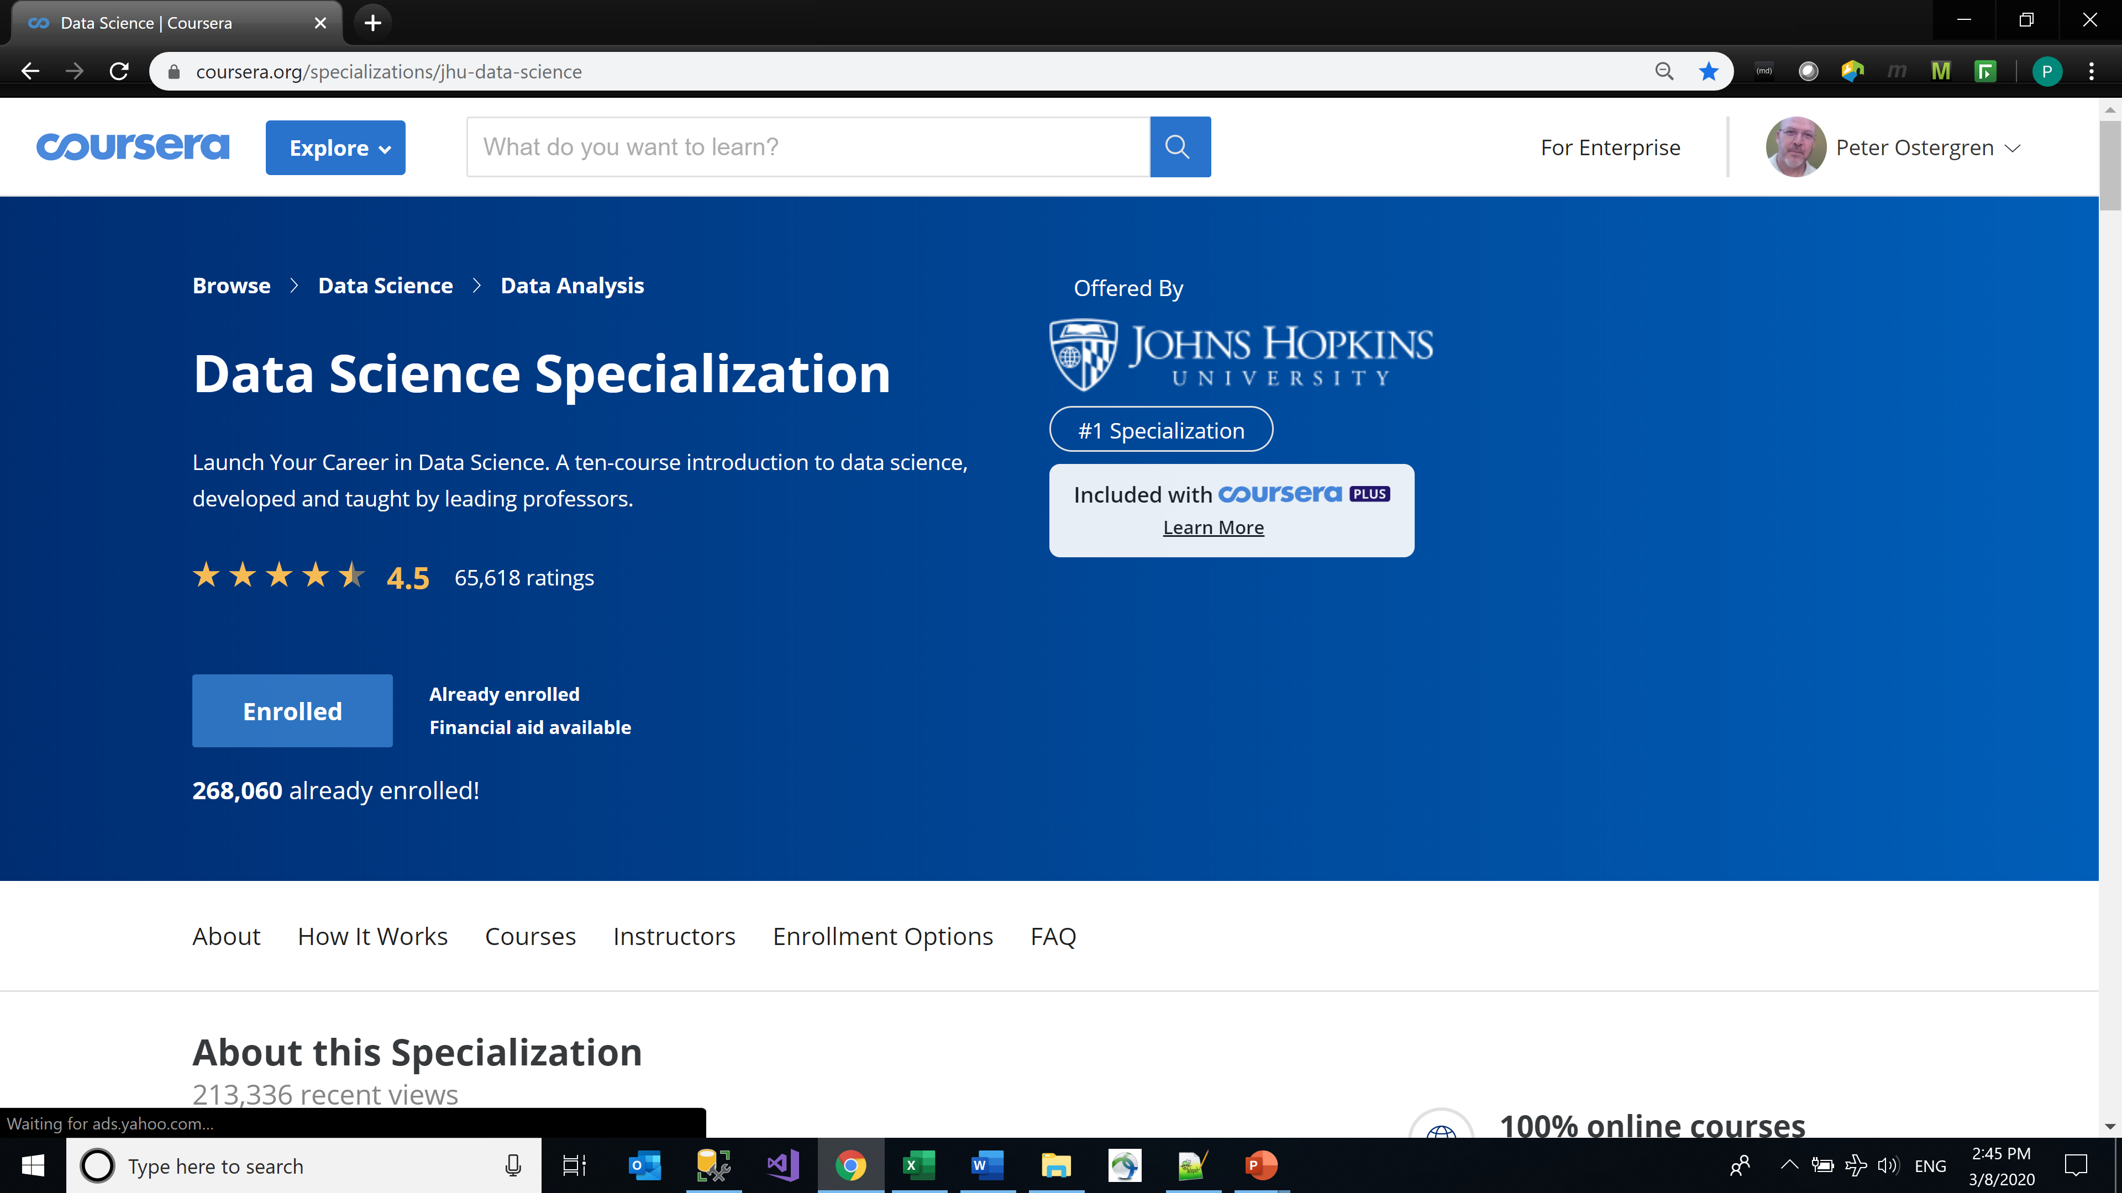
Coursera
Notes:
This consists of 10 courses

Slide 8
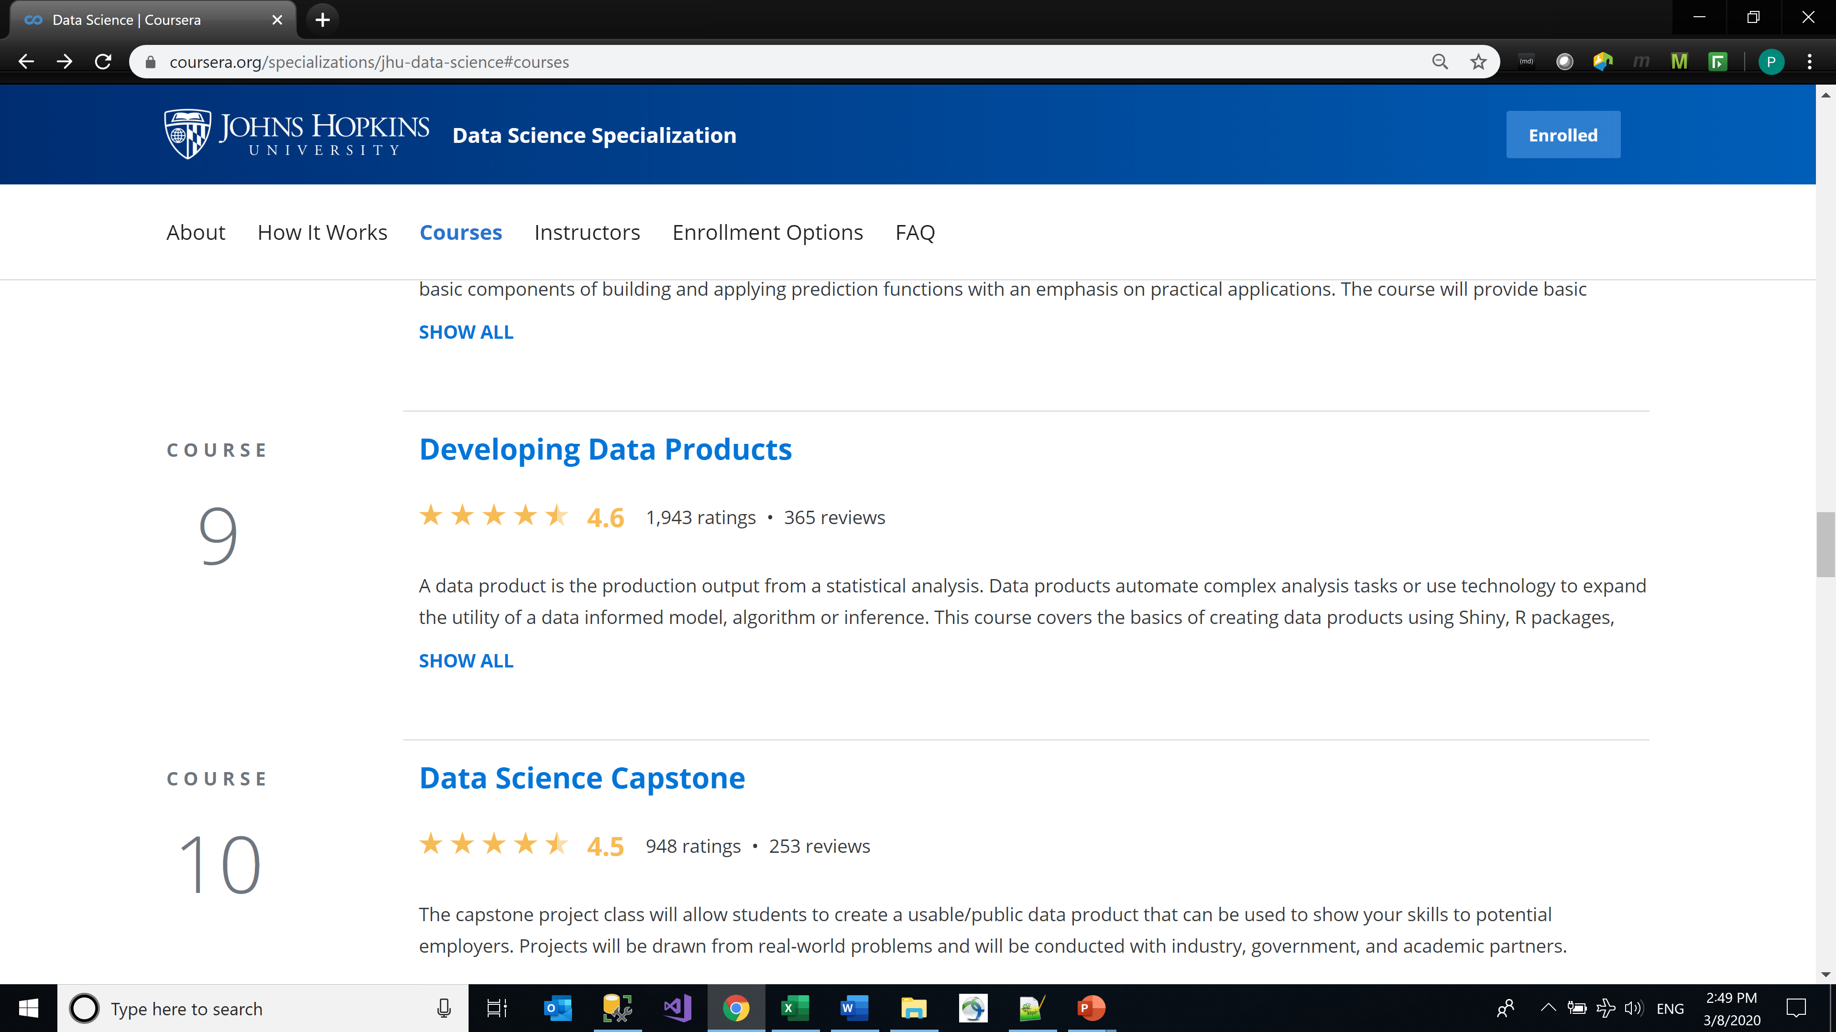
Coursera
Notes:
One left to go.

Slide 9
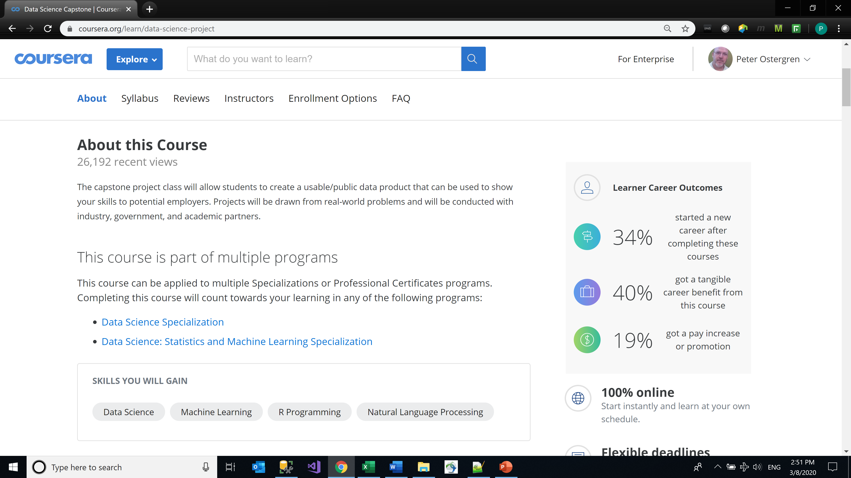
Coursera
Notes:
R Programming and Natural Language Processing

Slide 10
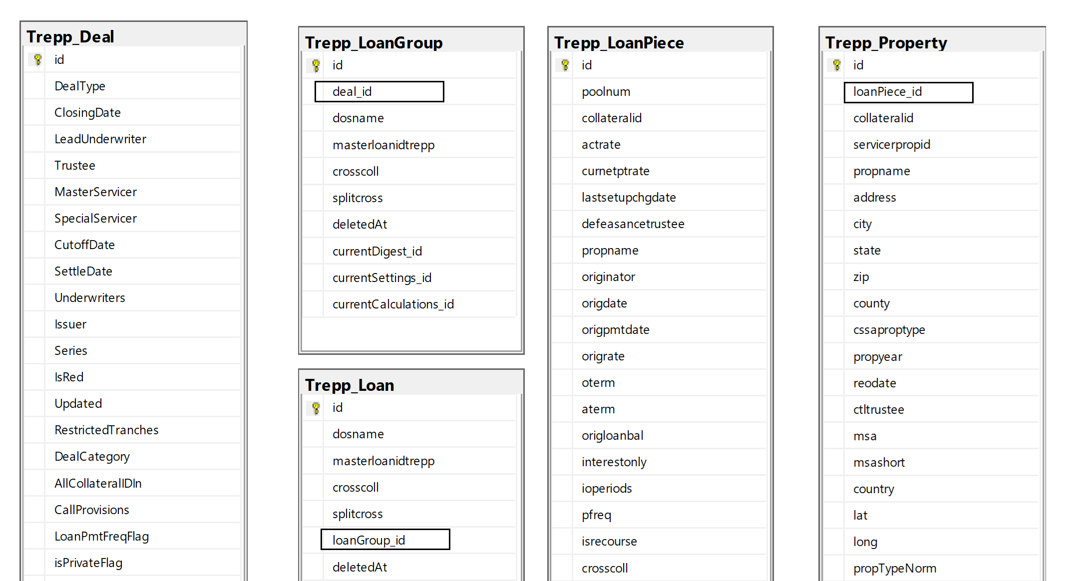
CMBS
Notes:
This is just like the challenges I have been working with

Slide 11
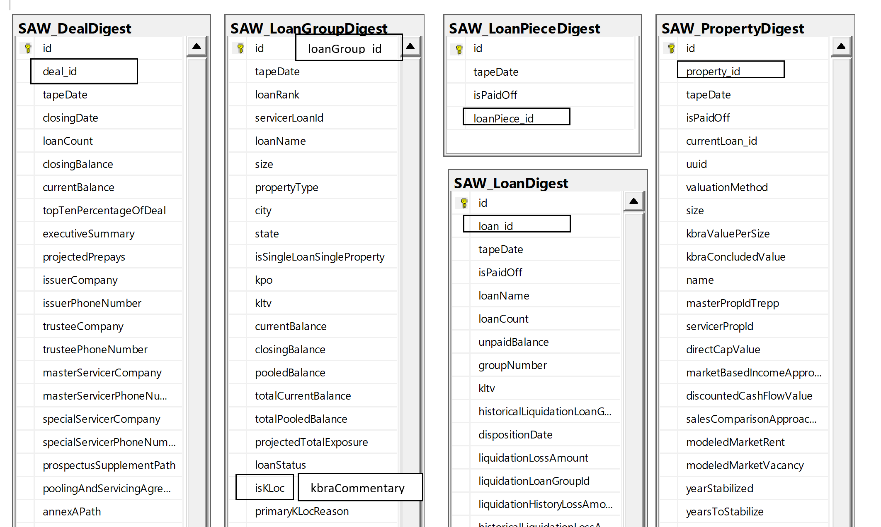
CMBS
Notes:
MV pointed me to the saw database where I can do “Analysis of Comentary”

Slide 12
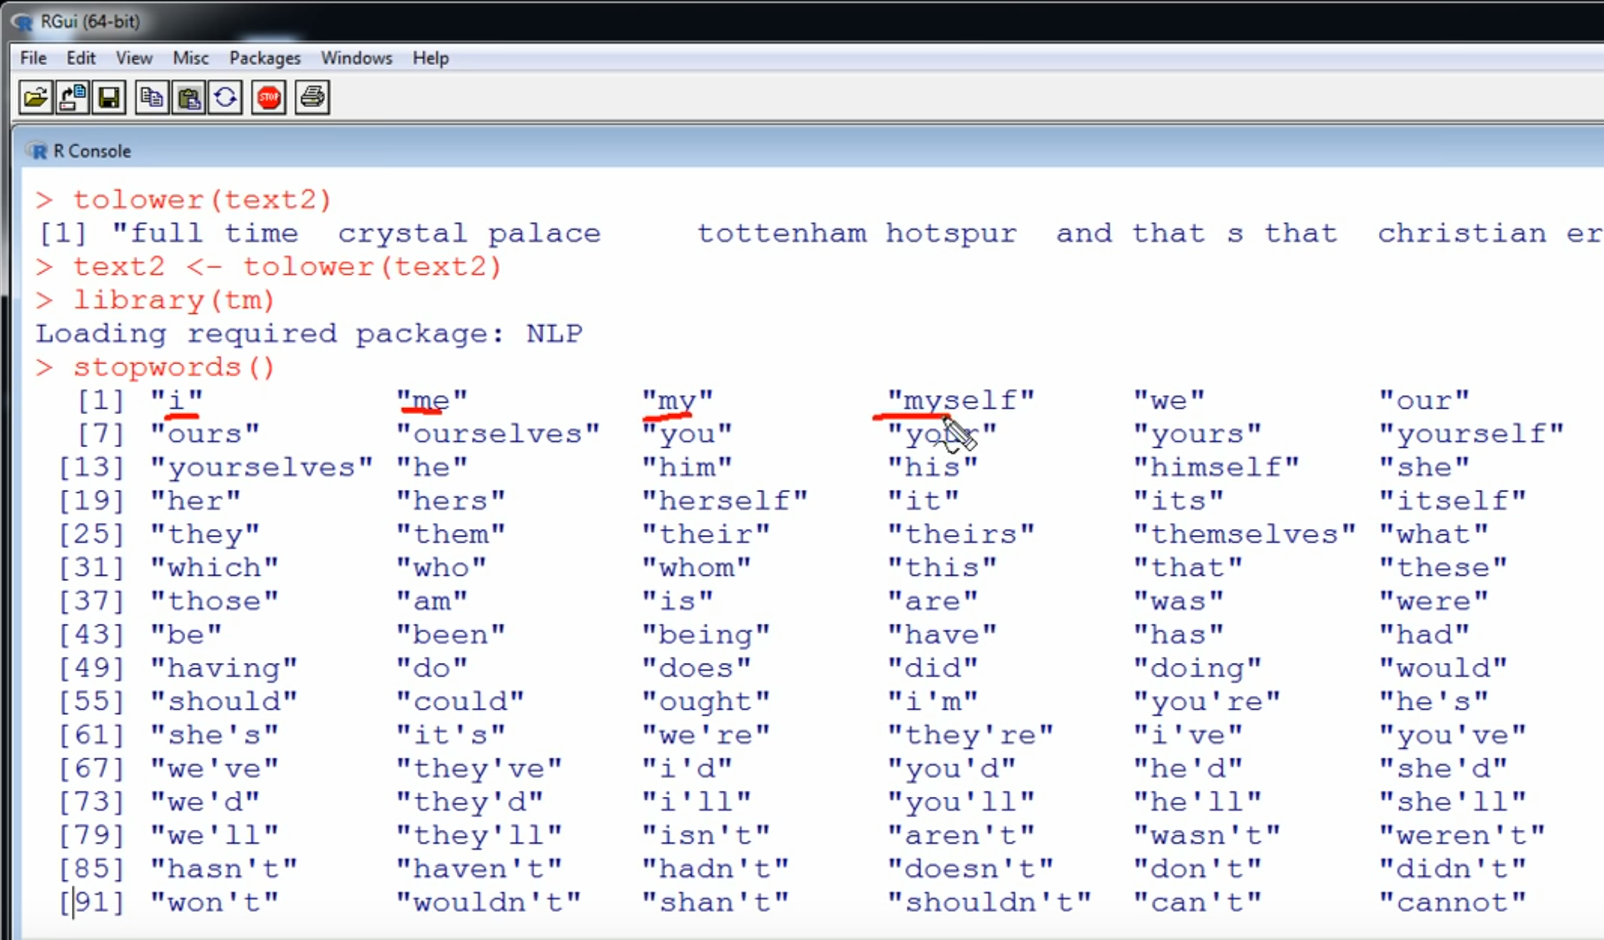
Text Mining
Notes:
Use libraries built on packages like NLP with built in things like stopwords() objects

Slide 13
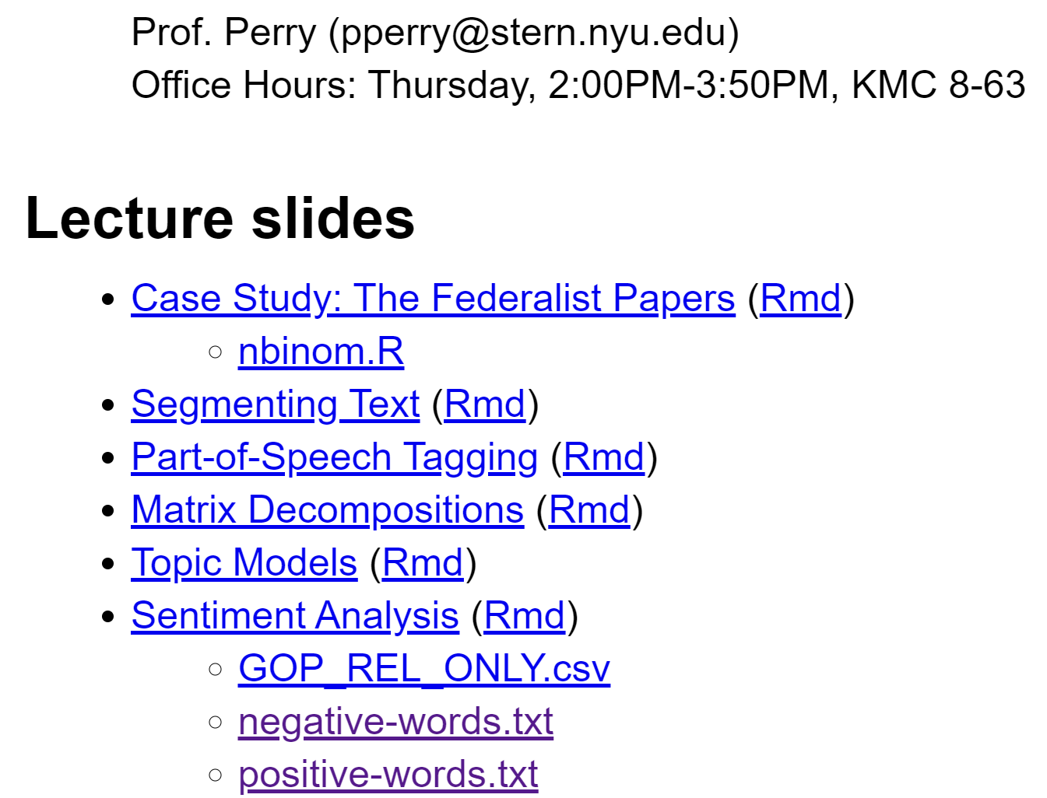
Text Mining
Notes:
Academic researchers have compiled lists of negative and positive words.

Slide 14
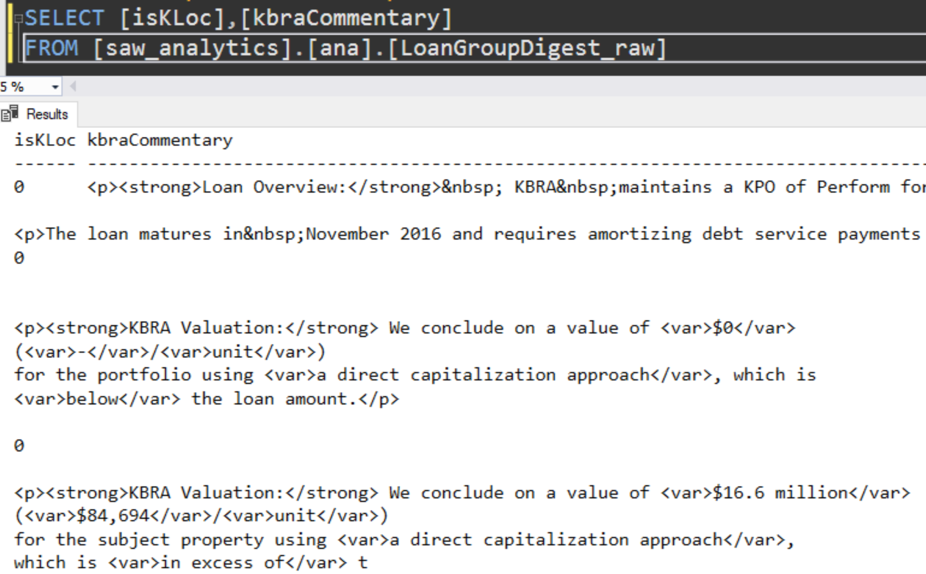
Match R to Real World
Notes:
At this point doubts began to creep in.

Slide 15
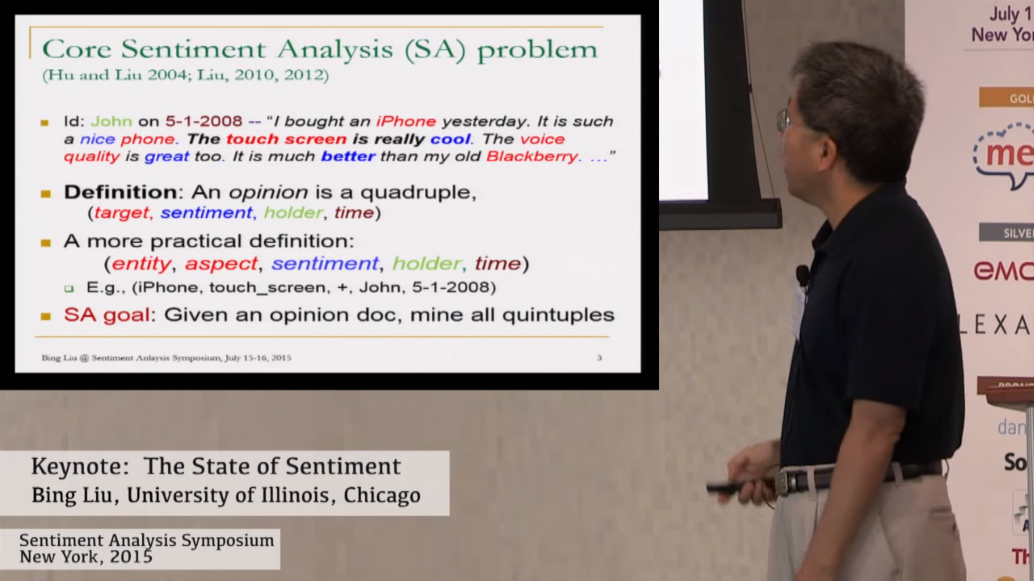
Cutting Edge Research
Notes:
Quadruples, Quintuples, yes but how?

Slide 16
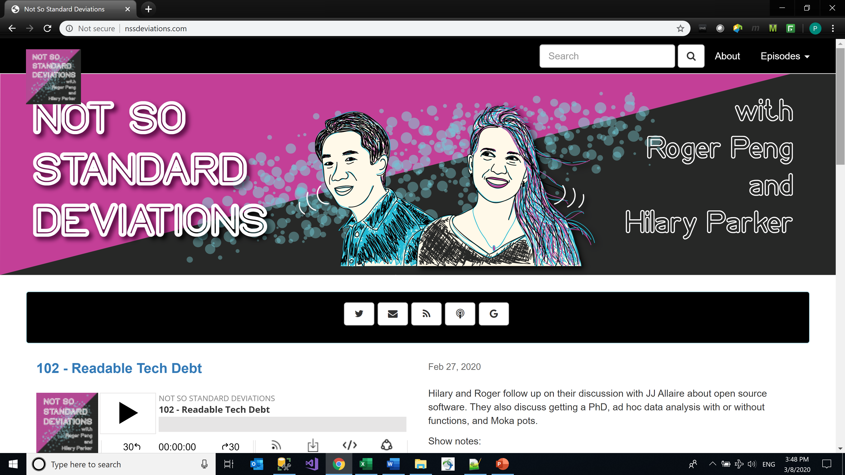
Professor from Johns Hopkins
Notes:
“My” professor’s podcast.

Slide 17
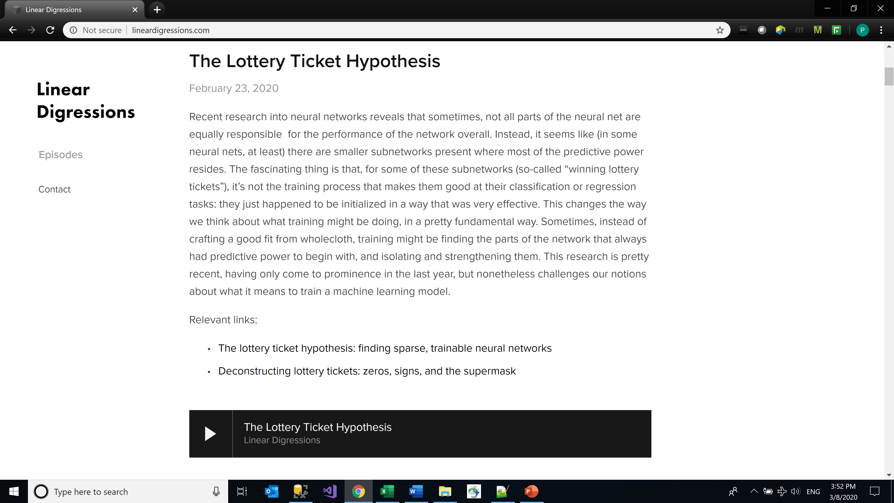
Another Podcast
Notes:
A fun and informative podcast, trainable neural networks.

Slide 18
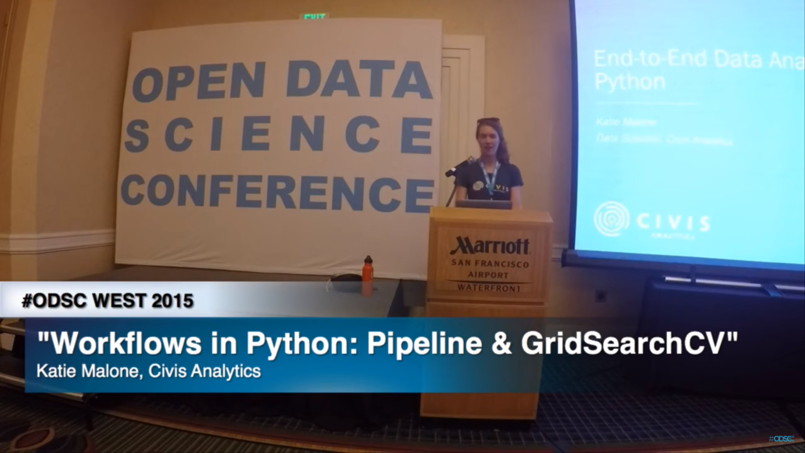
Podcaster Bona Fides
Notes:
I have always had a lot of respect for presenters. They know what they are talking about.

Slide 19
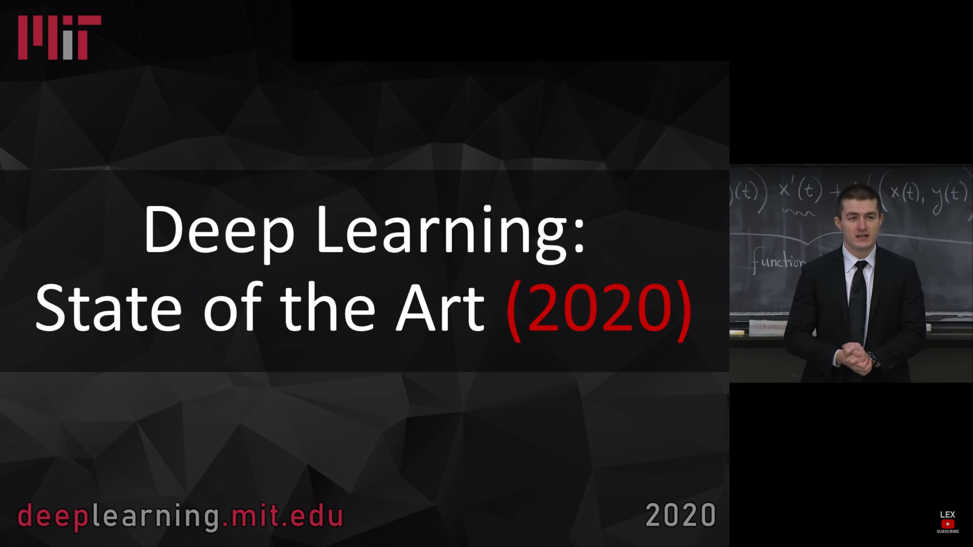
Bona Fides - MIT
Notes:
Who is smarter than the people at MIT?

Slide 20
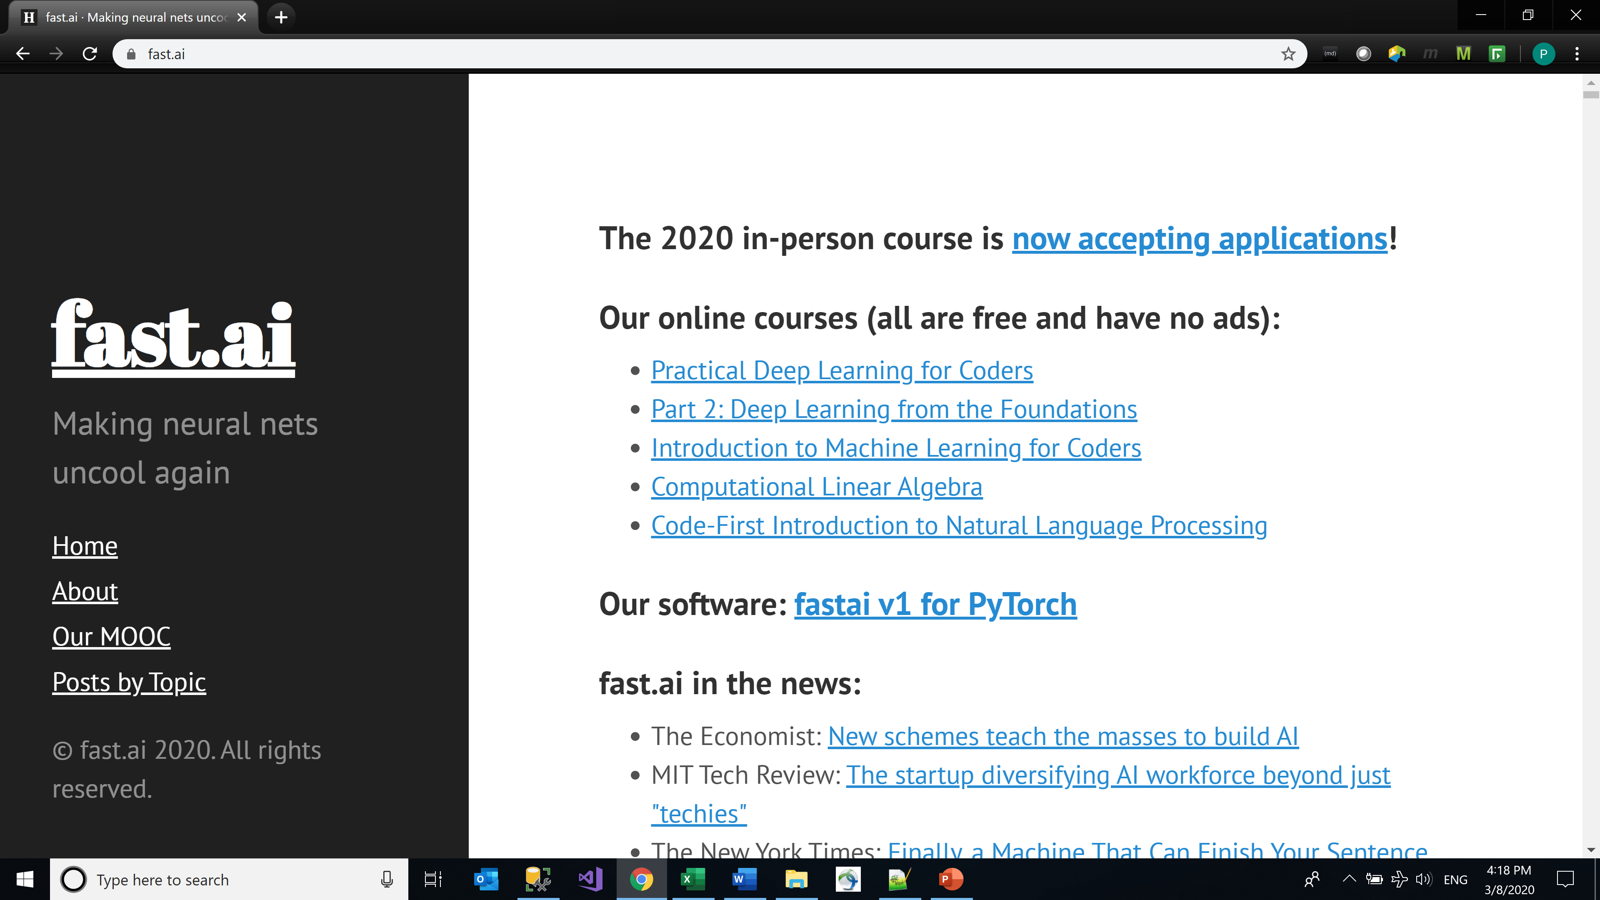
Both Bona Fides Pointed me to fast.ai
Notes:
Free, for Coders. Both Katie and Lex pointed me to fast.ai

Slide 21
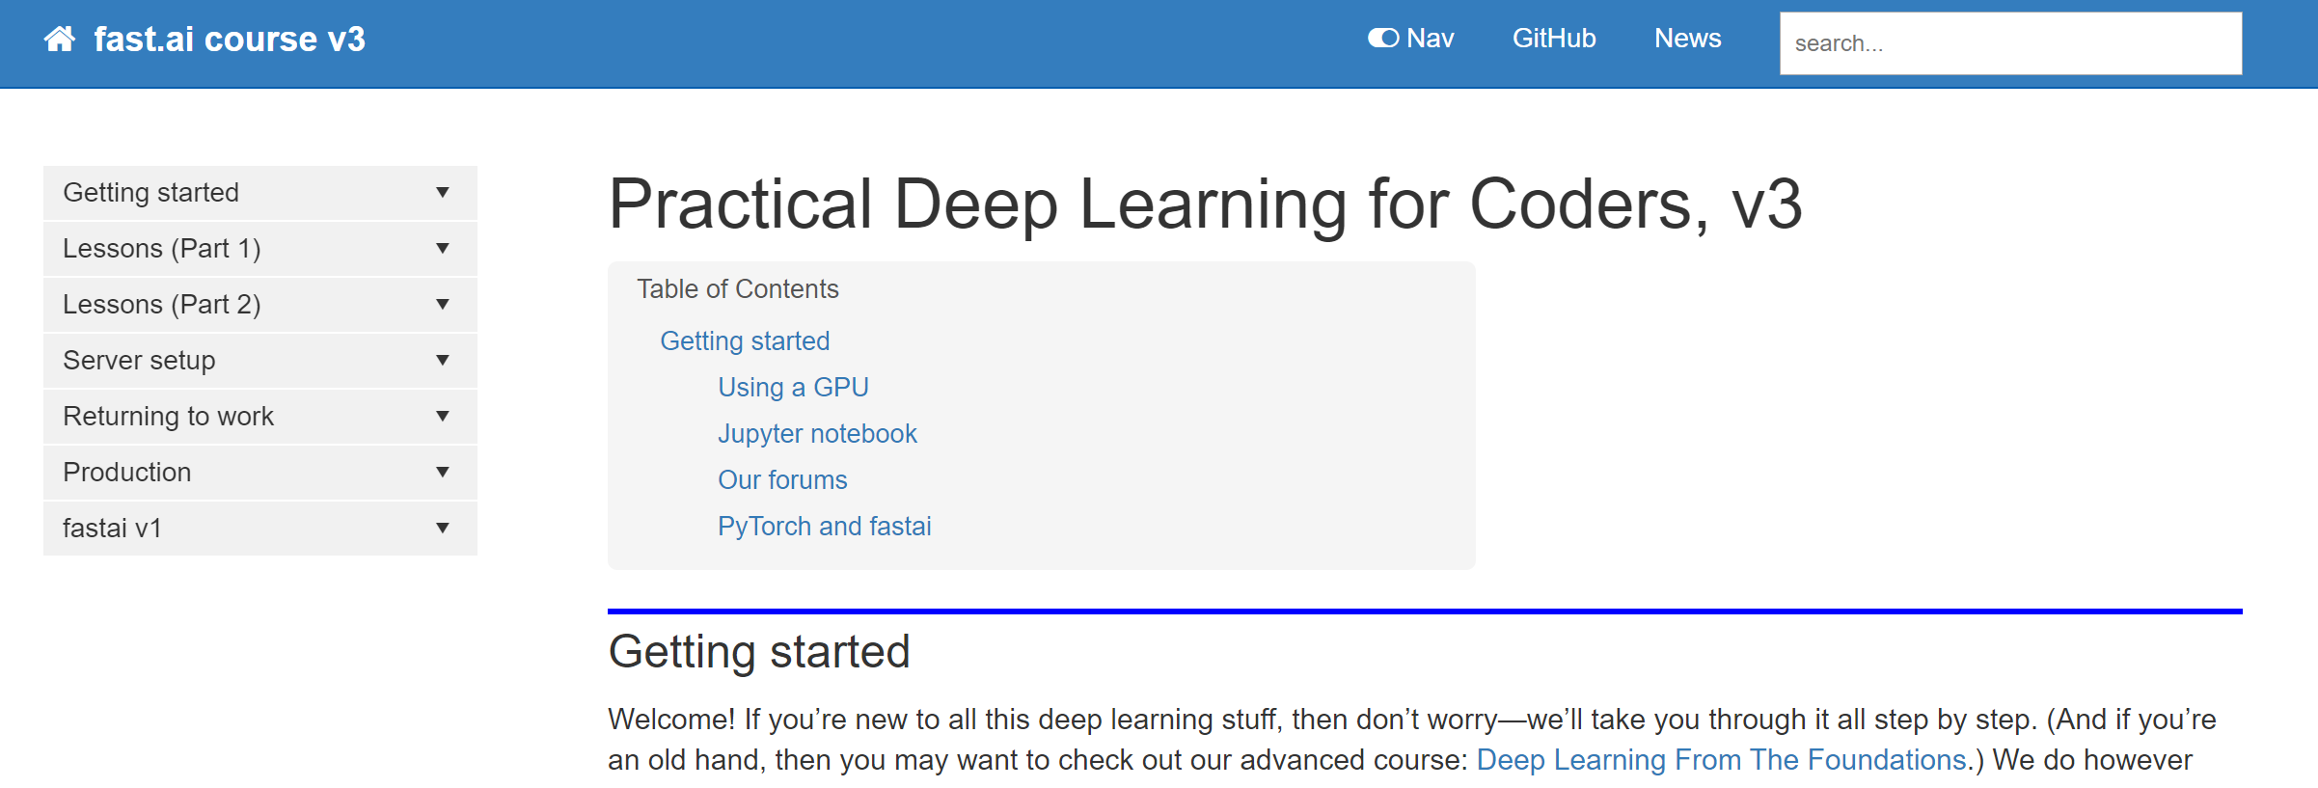
fast.ai
Notes:
Note: GPU, Jupyter, PyTorch.

Slide 22
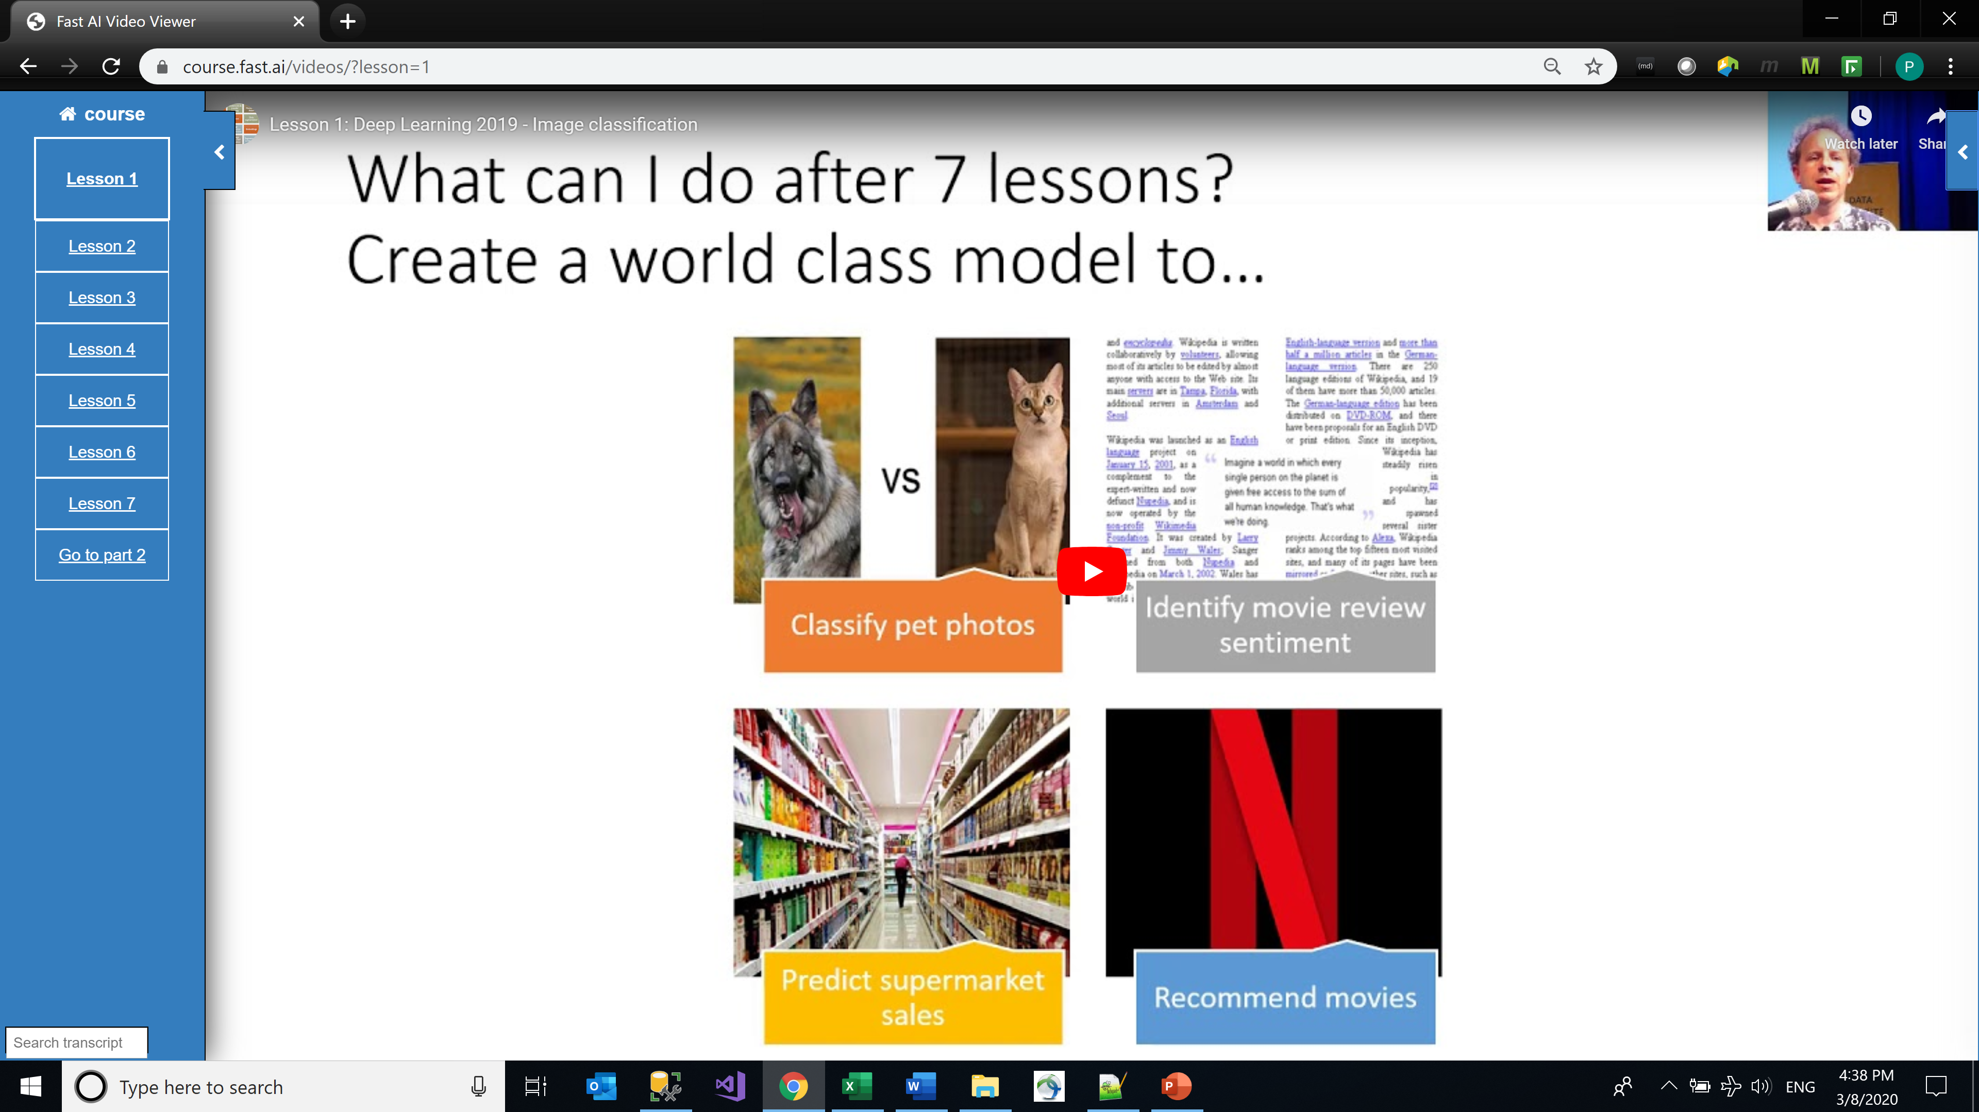
fast.ai
Notes:
World class I like, pet photos not so much. Movie review sentiment. Yes sentiment analysis.

Slide 23
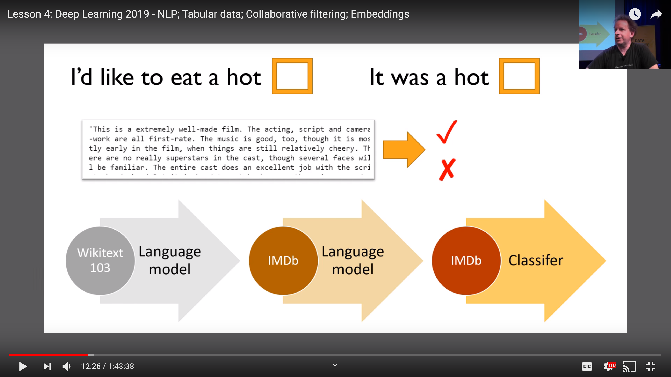
fast.ai
Notes:
Deep into the course he shows how the magic happens. Dog and Day are supplied by your phone. Your phone has a trained LM. A trained LM can ‘read’ a movie review and tell whether it was negative or positive. Again researchers pushing the boundaries of knowledge, (human or otherwise) have created pre-trained models of simple English. The next step is to use the fast.ai API to train a language model in not the IMDB domain, but rather in the the CMBS domain to a ‘read’ and classifiy the commentary that our Analysts write and determine whether they are KLOC’s or not.

Slide 24
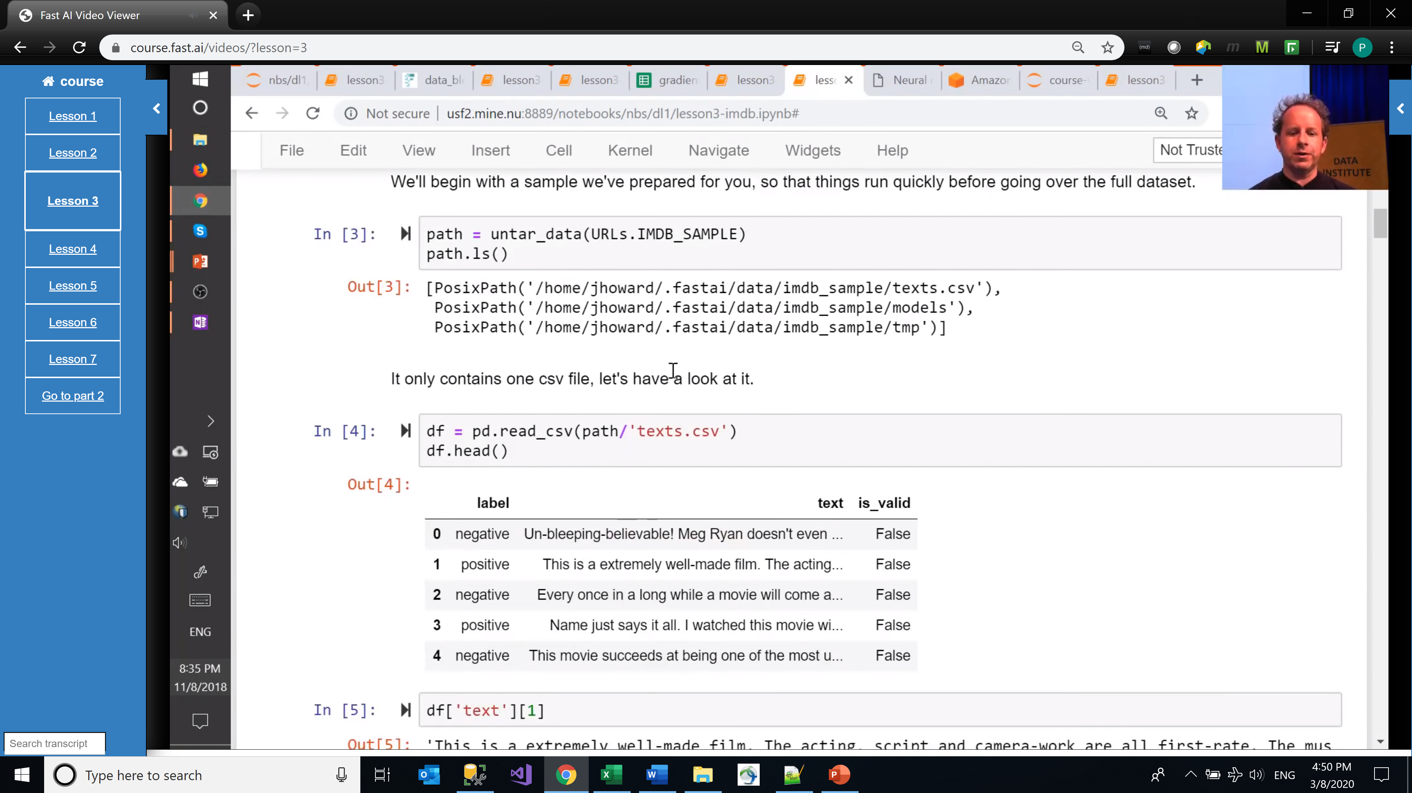
fast.ai
Notes:
His teaching style is hands-on, practice first, theory second. In lesson three I see something that looks like a commentary.

Slide 25
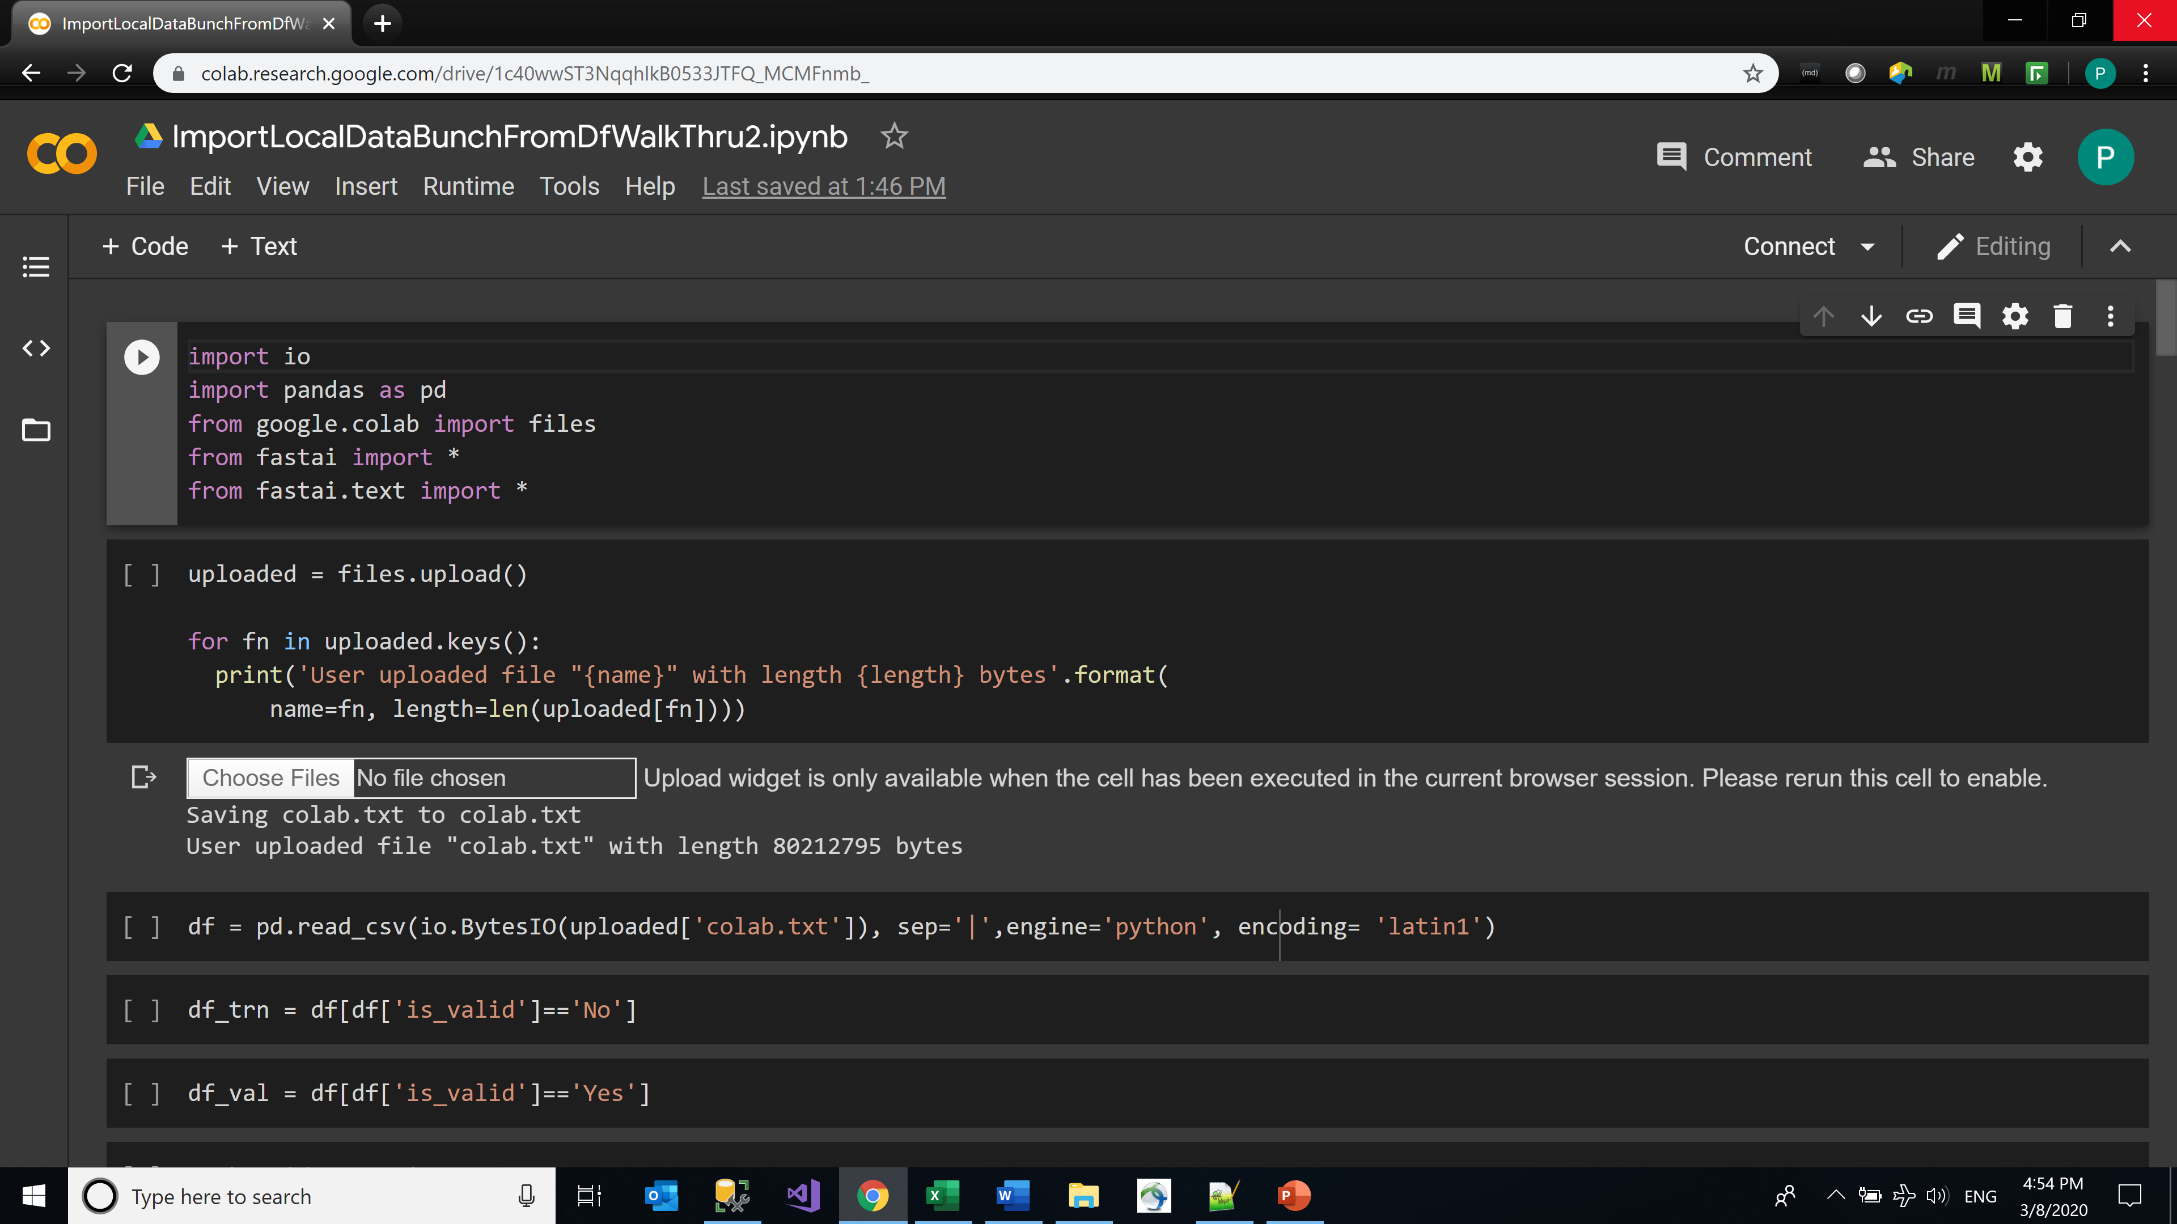
Jupyter Notebook
Notes:
In a Jupyter Notebook, import the fastai librairies, import data…

Slide 26
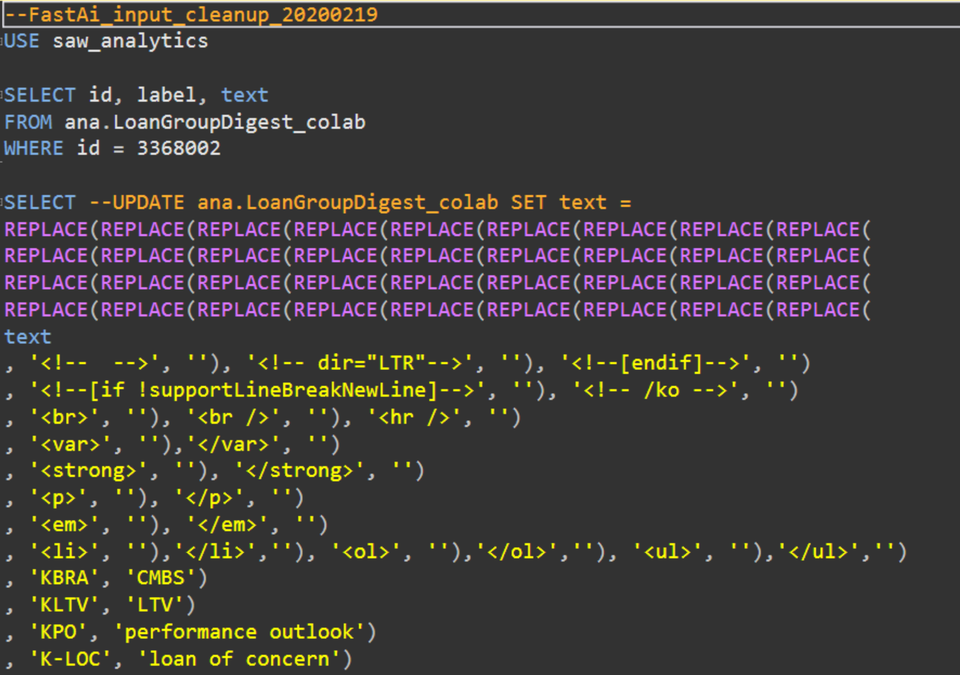
Input Data
Notes:
The data has been scrubbed.

Slide 27
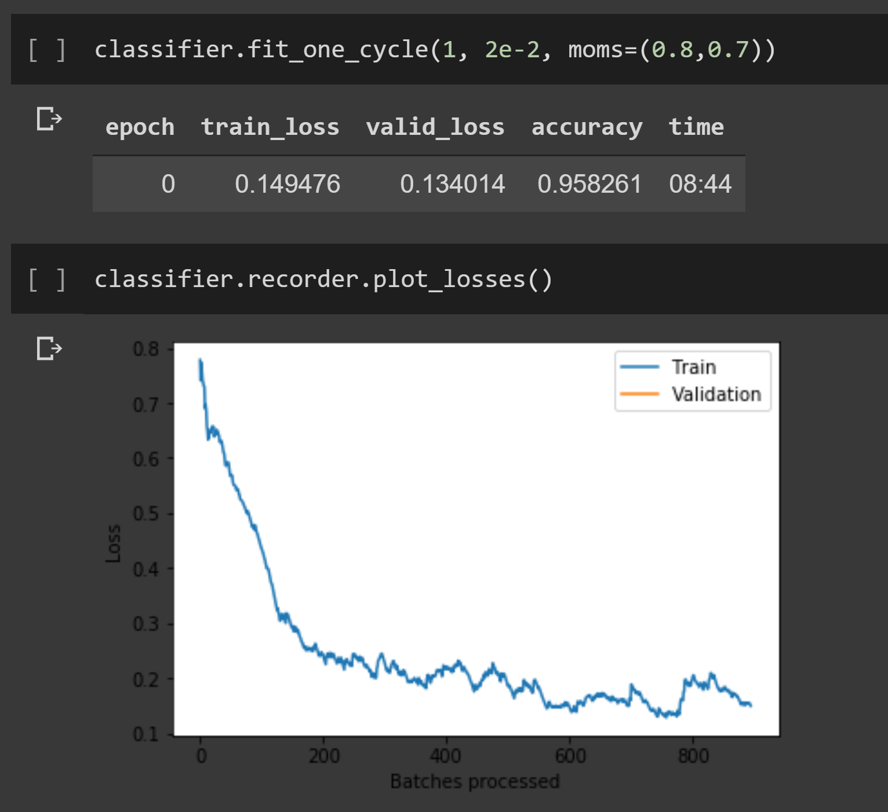
After training the model
Notes:
accuracy 0.958 ? unbelievable.

Slide 28
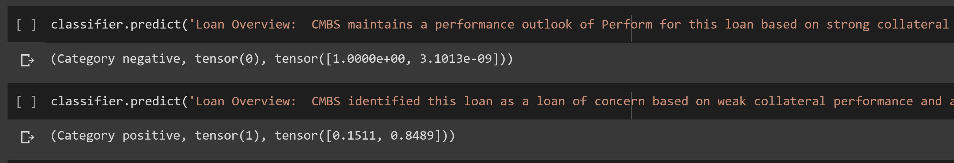
What can the model do?
Notes:
Feed in a commentary and the model will classify it. I.E. predict whether it is a KLOC or not.

Slide 29
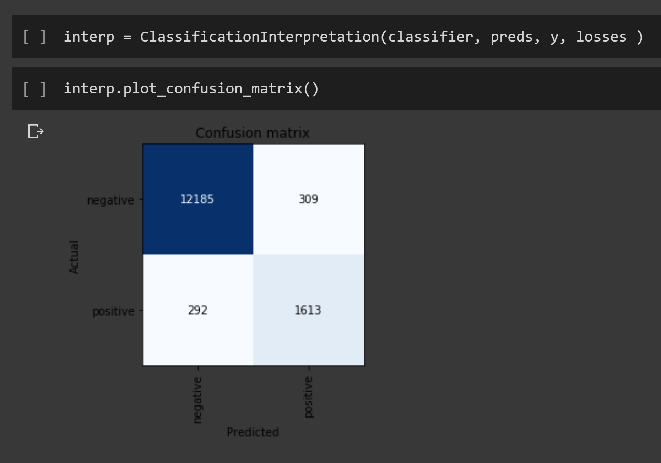
How do we interpret Accuracy?
Notes:
The “Confusion Matrix” is a standard way of interpreting accuracy

Slide 30
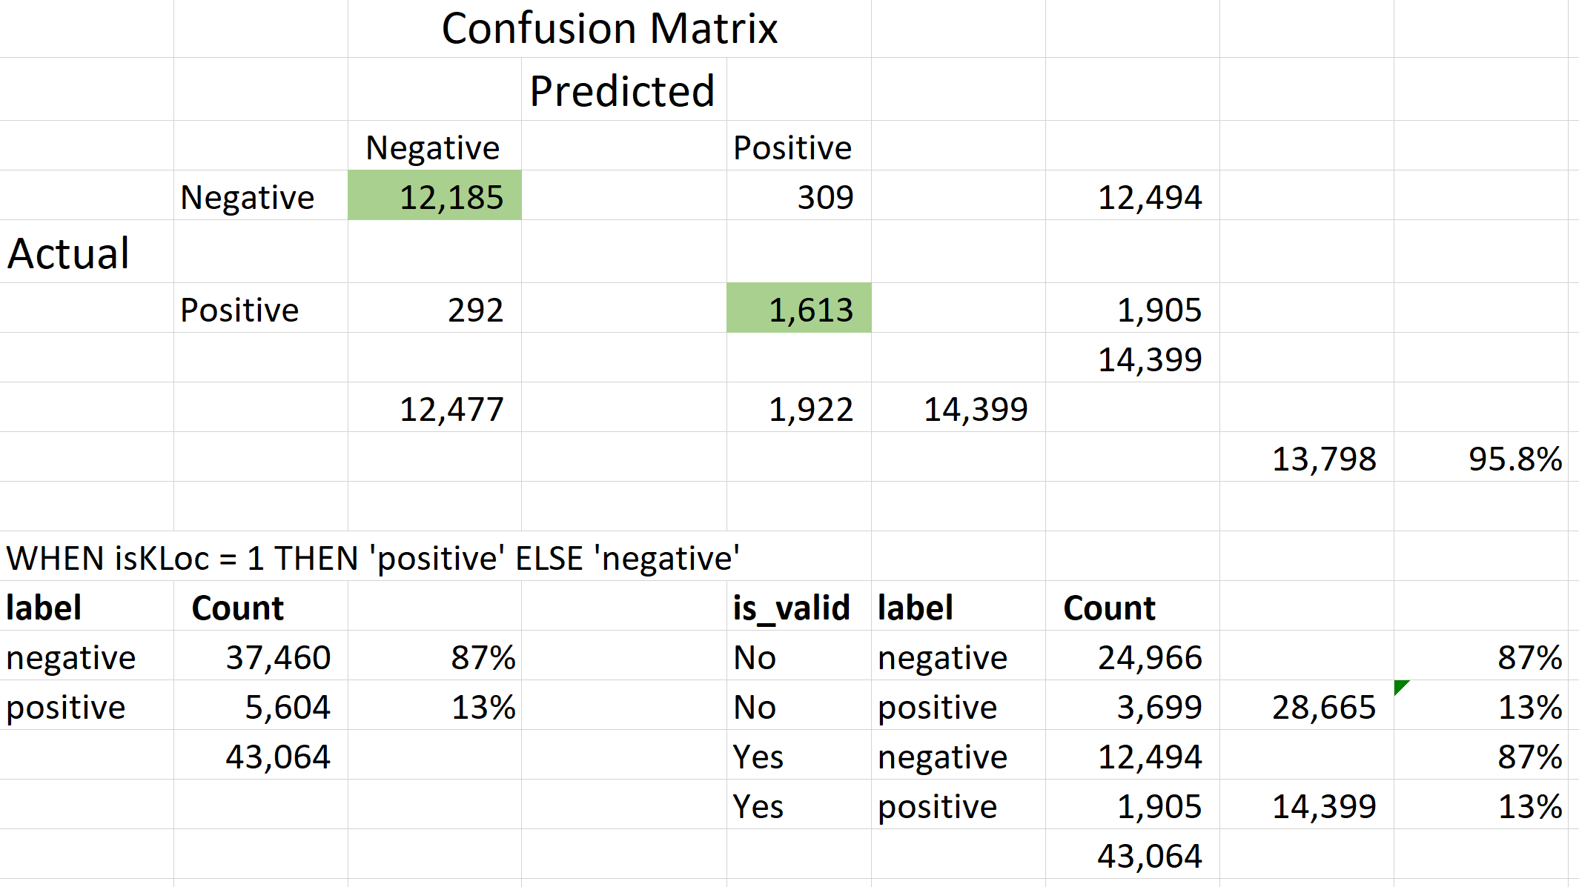
Confusion Matrix
Notes:
Deep dive on the Confusion Matrix

